Slide 1
Developing an ML Model End-to-End
Training, tuning, evaluating, and selecting an ML model

Slide 2

Instructor Introduction
John Sukup is a 16-year data professional
Consumer market research
Data science and data strategy
ML Engineering/MLOps
Acted as the lead professional trainer for machine learning and related topics at Cisco Systems
Featured in Forbes, Oracle, and Data Science Central
Founder and Principal Consultant at Expected X, a data strategy and MLOps consultancy
AI/ML Release Engineer at Levi Strauss & Co.

Slide 3
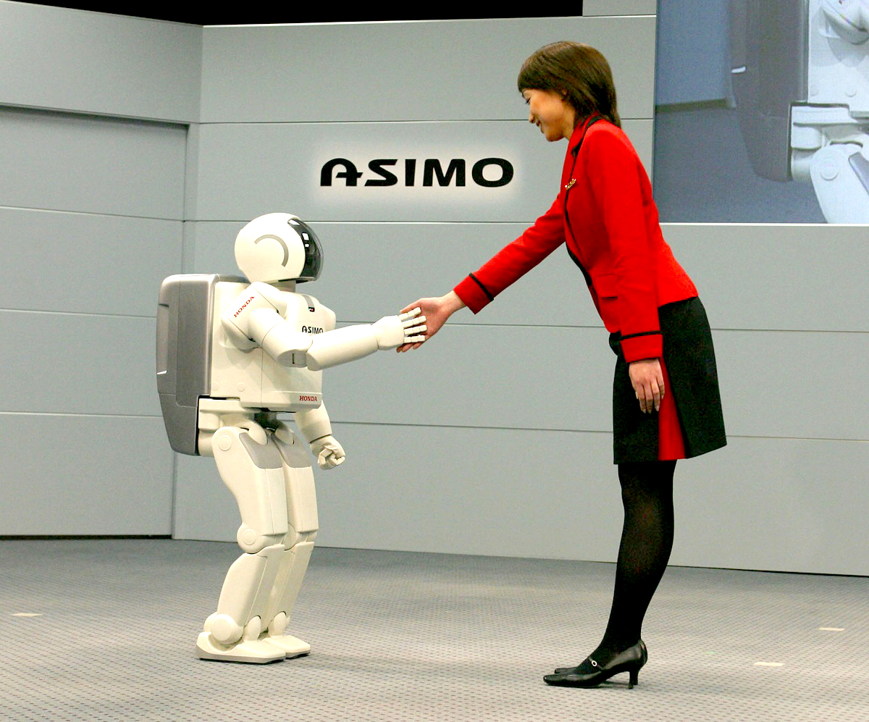
Course Introduction
By the end of this hands-on course, you’ll understand:
The phases of the Cross-Industry Standard Process for Data Mining (CRISP-DM) framework
Exploratory Data Analysis (EDA) and data preparation/transformation
Stages in developing and evaluating an ML model
Long-term considerations for model maintenance (MLOps)
Prerequisites:
Basic understanding of ML, math, statistics and probability
Ability to understand mathematical notation
1-3 years of experience programming in Python
Please have Anaconda Cloud notebooks (https://nb.anaconda.cloud) open

Slide 4
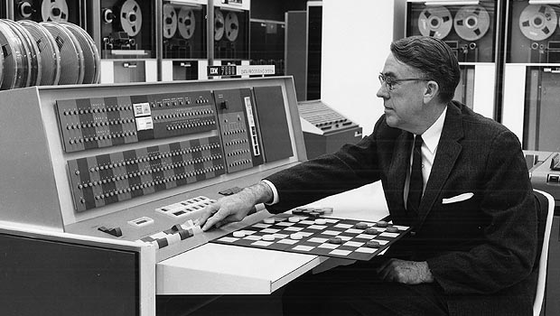

What is Machine Learning Anyway?
“[Machine Learning is the] field of study that gives computers the ability to learn without being explicitly programmed.”
—Arthur Samuel, Computer Scientist (1959)
“Machine Learning is a field of study that involves developing algorithms and models that can learn patterns and make predictions or decisions based on data, without being explicitly programmed. It involves using statistical and computational methods to train machines to recognize patterns and make decisions based on past experiences.”
—ChatGPT, Generative Language Model (2023)

Slide 5
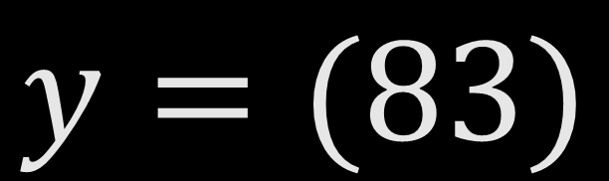
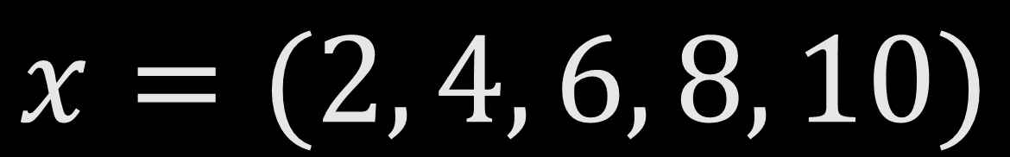
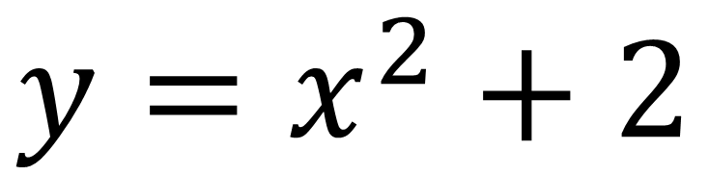
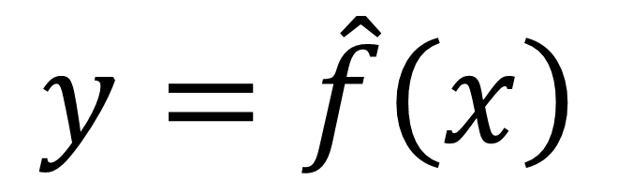

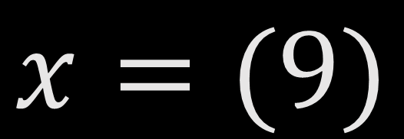
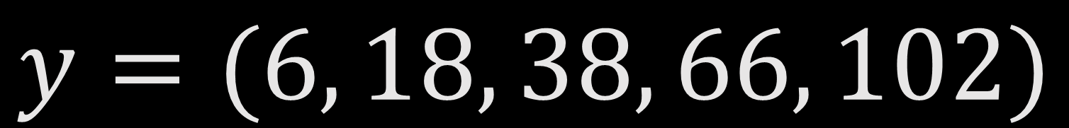
Machine Learning Example
$$x=(2, 4, 6, 8, 10)$$
$$y=(6, 18, 38, 66, 102)$$
$$x=(9)$$
$$y=(?)$$
$$y=(83)$$
$$y=\hat{f}\left(x\right)$$
$$y=x^{2}+2$$

Slide 6
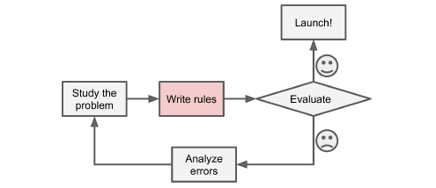
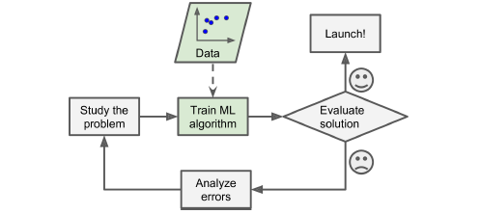
ML vs. Traditional Programming
Traditional Programming
Machine Learning

Slide 7
Introduction to CRISP-DM Framework

Slide 8


CRoss-Industry Standard Process for Data Mining
The ML Real Estate Company

Slide 9
Business Understanding

Slide 10
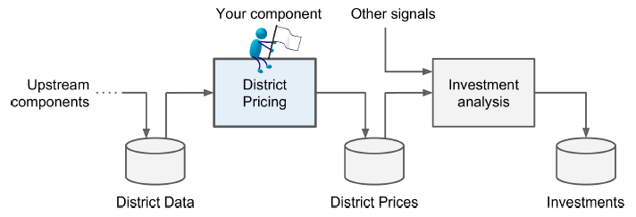
Problem Framing
What is the expected use and benefit of the model?
What is the current/ ‘baseline’ approach?
What type of problem is this?
Supervised/Unsupervised?
Classification/Regression?
Batch/Real-time?
What performance metric will be used?

Slide 11
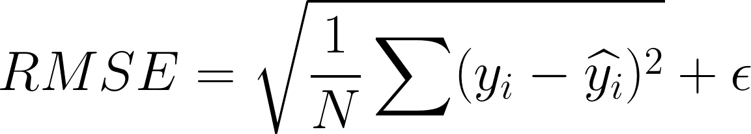
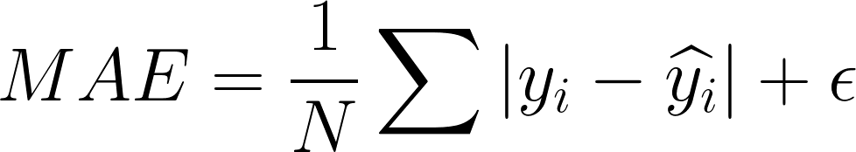
(Model) Performance Measures and (Business) KPIs
Model success determined by performance metrics
Root Mean Squared Error (RMSE) measures squared difference between actual and model-estimated values, penalizing bigger errors
Mean Absolute Error (MAE) measures absolute difference between actual and model-estimated values, allowing for outliers
Both measure distance between vectors
(Model) Performance Measures

Slide 12
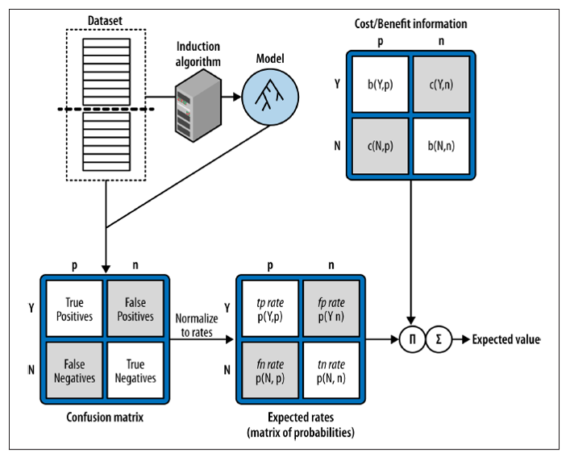
(Model) Performance Measures and (Business) KPIs
Financial KPIs
Revenue/Profit
Average Annual Expenses
Operational/Process/IT KPIs
Total Cycle Time
System/Infrastructure Costs
The Expected Value Framework
What is the estimated probability of a predicted outcome? (Model-centric)
What is the estimated value of a predicted outcome? (Business-centric)

Slide 13
Jump to Anaconda Notebooks!

Slide 14
Exploratory Data Analysis and Preparation

Slide 15
Data Cleansing and Transformations
Data Understanding
Collect initial data
ETL preparation
Data governance report
Describe data
Format, quantity, metadata
Data description report
Verify data quality
Identify errors
Data quality report
Data Preparation
Create training/testing sets
Explore and visualize data
Simple statistical analyses
Gain insights to exploit
Feature correlations/relationships
Feature engineering
Data cleaning
Missing values, errors, and how to address
Handling categorical features
Feature scaling

Slide 16
Jump to Anaconda Notebooks!

Slide 17
END OF DAY 1

Slide 18
Homework Review

Slide 19
Model Development

Slide 20

Model Training and Evaluation
Train model on training data
Training multiple models with performance and KPI metric comparisons
Evaluation using cross-validation
Provides estimation of performance and how precise the estimation is
Create shortlist of candidate models for hyperparameter optimization

Slide 21
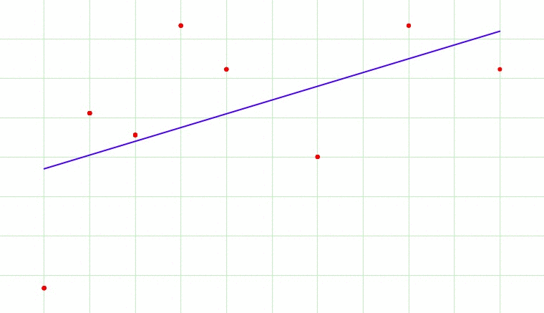
Model Selection
Techniques for Model Validation and Testing
Overfitting and Underfitting
Trained models should generalize well to the task they are designed for
Additional techniques exist to limit overfitting during training
Hyperparameter Optimization
Ensemble Methods
Feature Importances
Test Set Evaluation

Slide 22
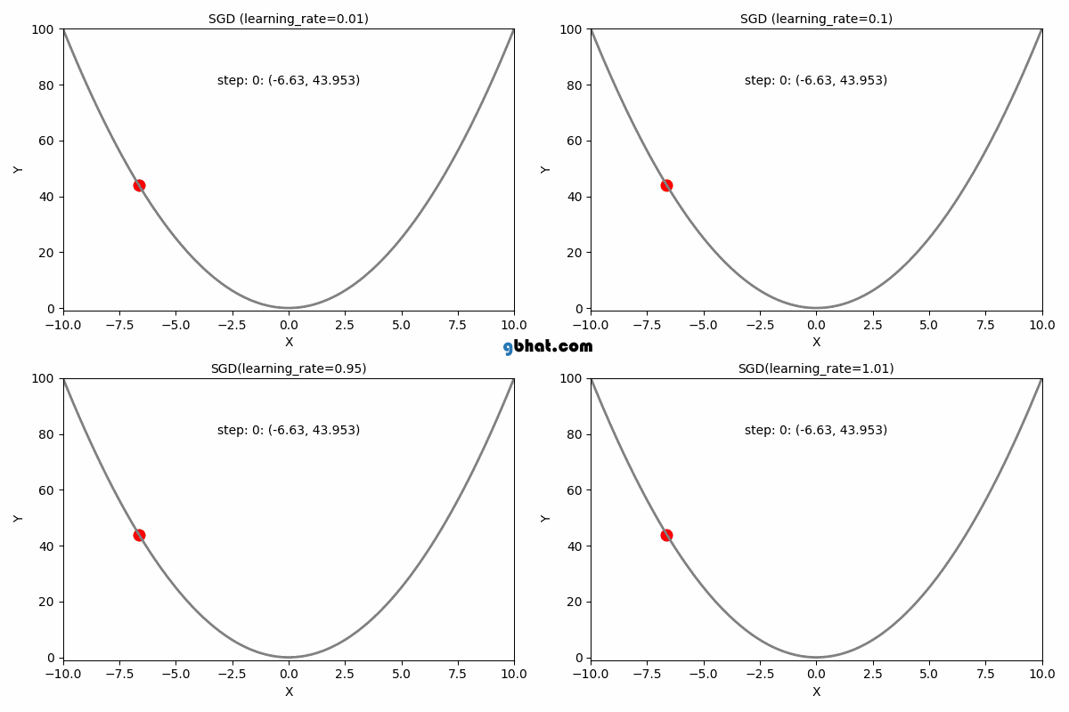
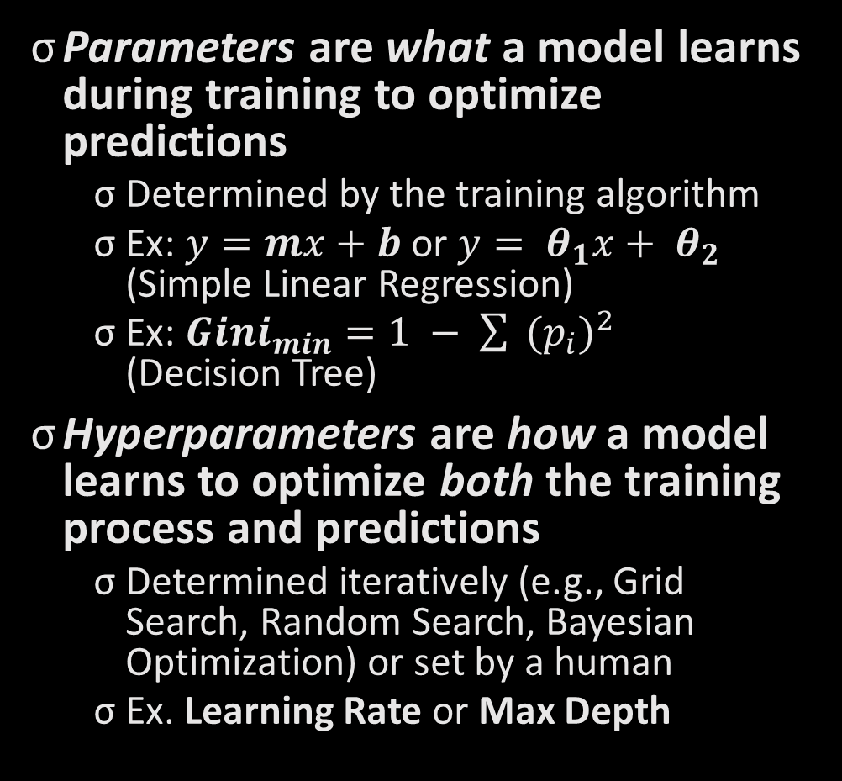
Hyperparameter Optimization
Parameters are what a model learns during training to optimize predictions
Determined by the training algorithm
Ex: $y=mx+b$ or $y= θ_{1}x+ θ_{2}$ (Simple Linear Regression)
Ex: ${Gini}_{min}=1 − \sum{ {(p_{i})}^{2}}$ (Decision Tree)
Hyperparameters are how a model learns to optimize both the training process and predictions
Determined iteratively (e.g., Grid Search, Random Search, Bayesian Optimization) or set by a human
Ex. Learning Rate or Max Depth

Slide 23
Jump to Anaconda Notebooks!

Slide 24
Considerations for MLOps

Slide 25
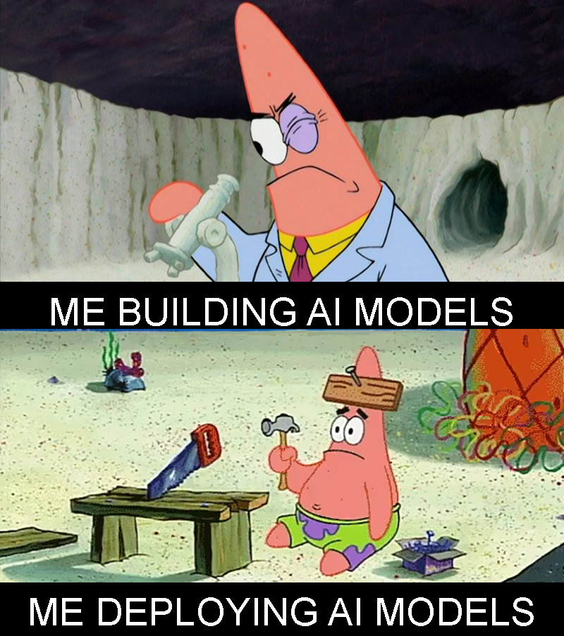
What is MLOps?

Slide 26

Considerations for MLOps
MLOps “closes the loop” and automates the ML pipeline
An extension of Software Development Lifecycle (SDLC) best practices:
Model Performance Monitoring
Data Validation
CI/CD/CT
Concept Drift (Model/Data)
Versioning (Model/Data/Code)
Experiment Tracking and Reproducibility
Observability and Explainability
Feature Store

